Slide 1
Traffic Accidents in the UK and How to Avoid Them
by Kevin Cui

Slide 2
The Data
Total Accidents: 1,504,049
Annual Average: 167,116
Annual Casualty: 225,768
Traffic Average: 364,070,907
Accident Chance: 0.05%
Traffic accident records released by UK Government
Data from 2005 - 2014
Contains metadata and more related information
Analyzed alongside Annual Traffic Flow data

Slide 3
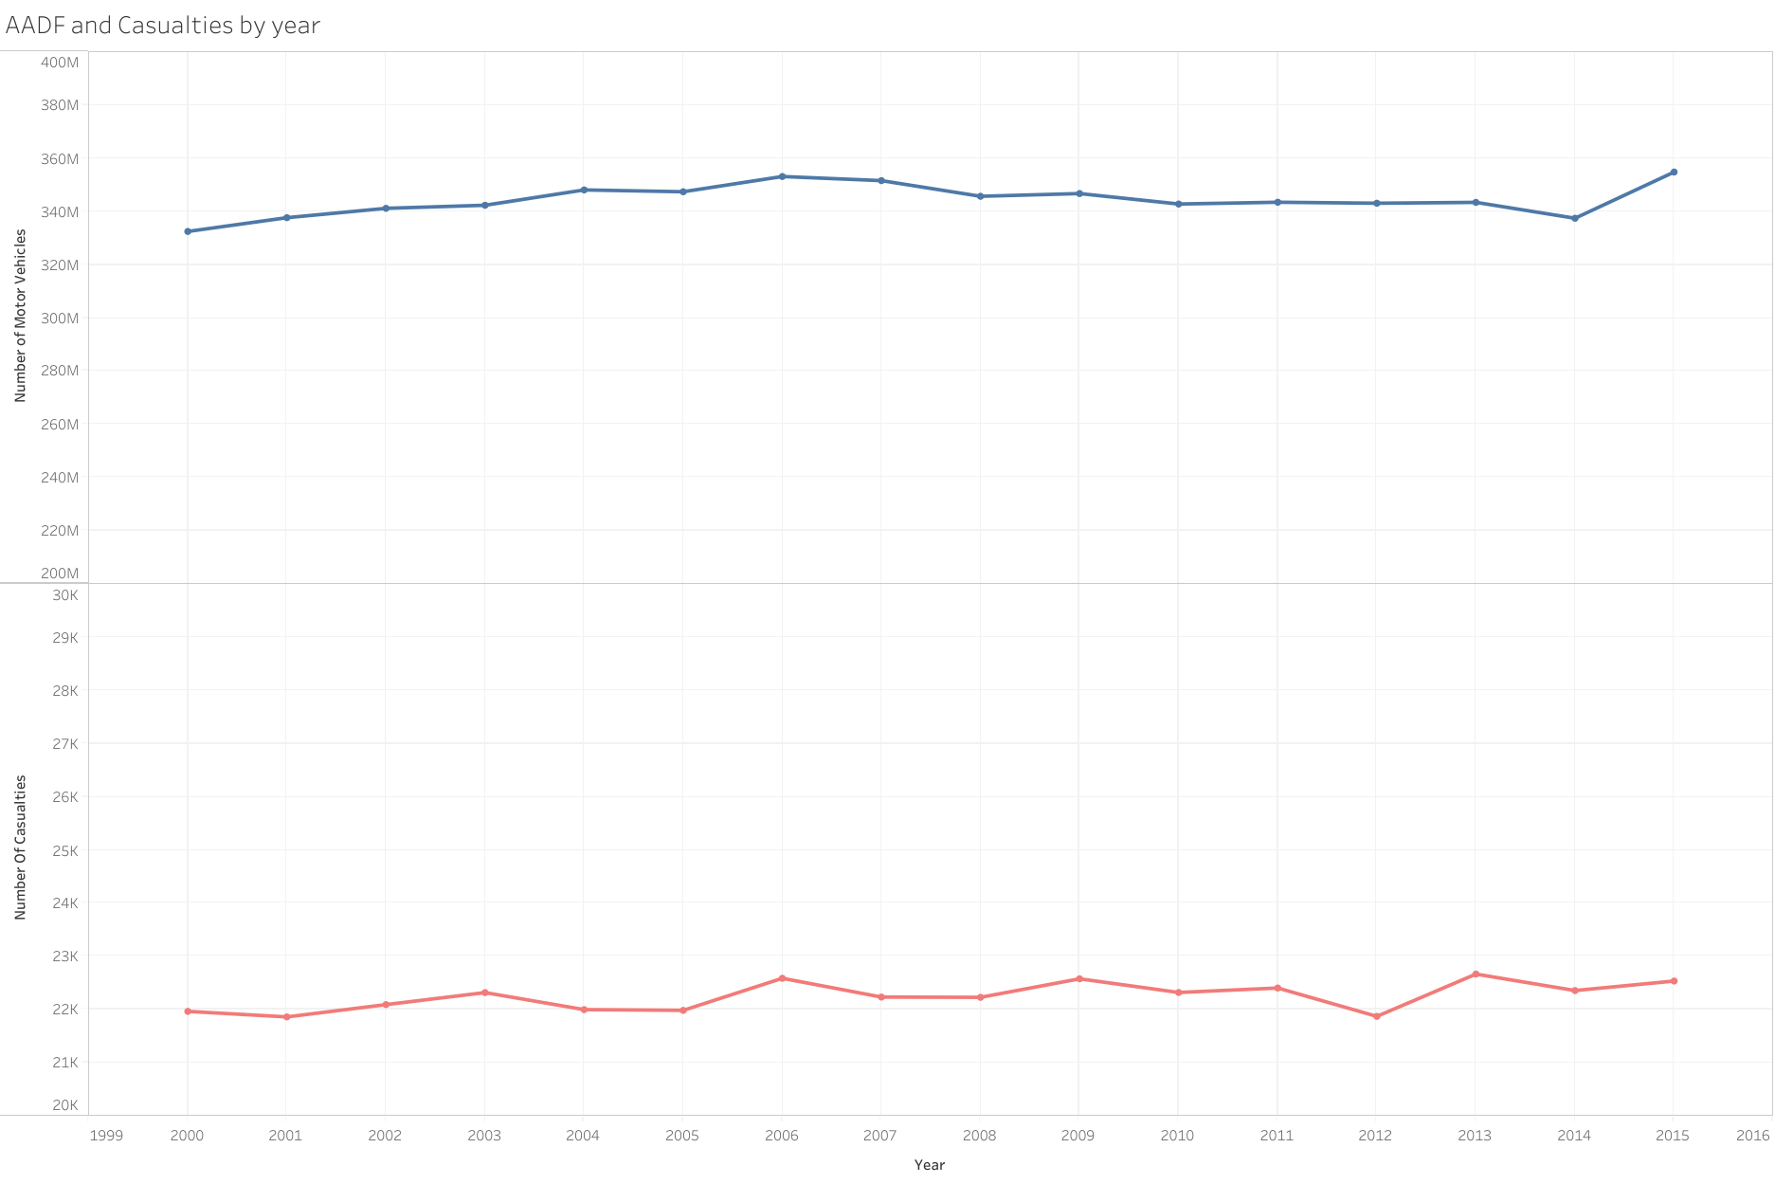

Slide 4
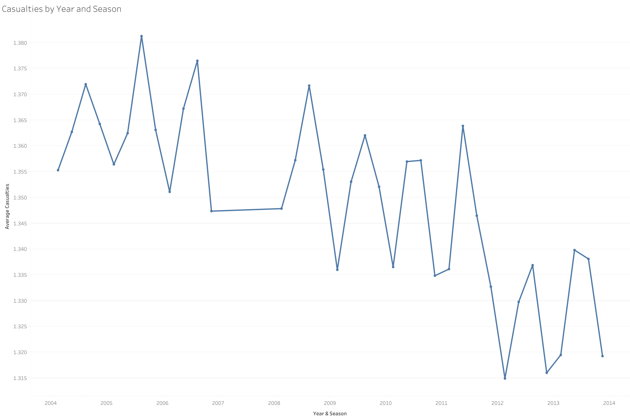

Slide 5
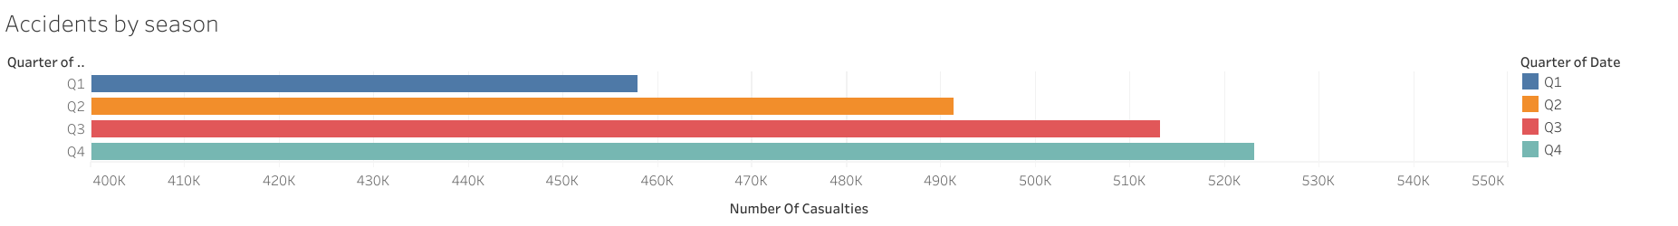
Correlation:
0.95

Slide 6
Seasonal Accidents?
→ Weather

Slide 7
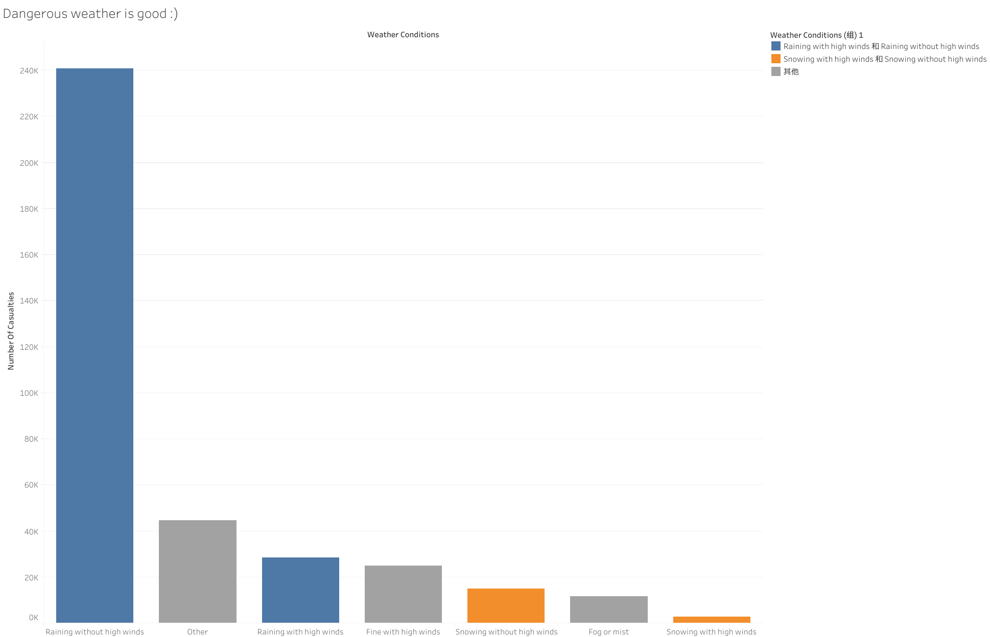

Slide 8
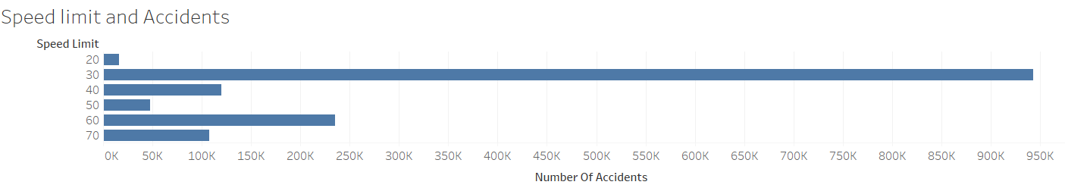
Speed Limits

Slide 9
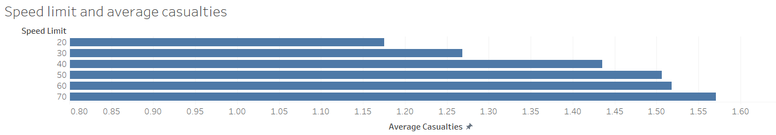
Speed Limits

Slide 10
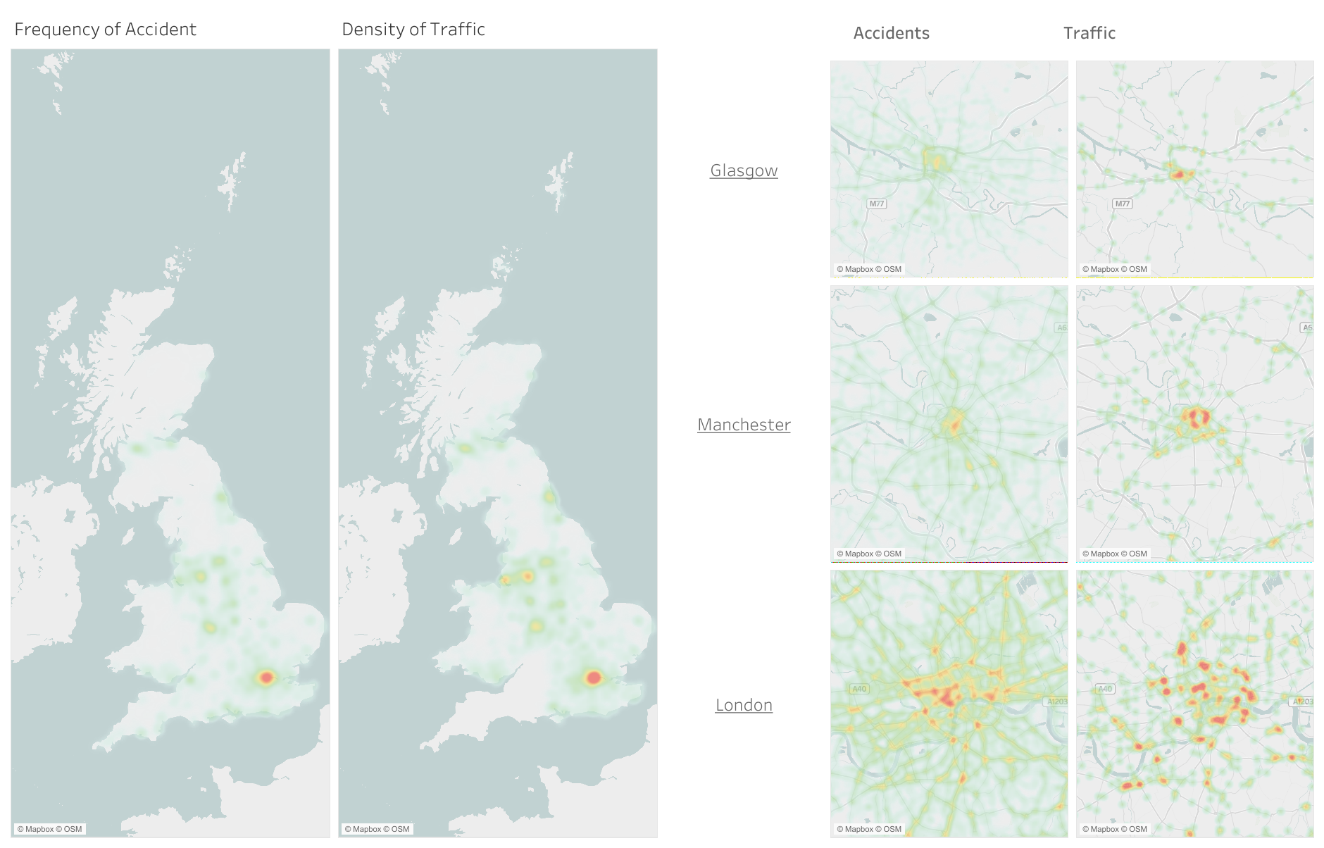

Slide 11
How to avoid traffic accidents?
Travel in Winter
Travel in hazardous weather
Avoid travelling on 30mi/h roads (~50 km/h)
Be cautious around, especially when entering / exiting busy areas

